Slide 1
Chirurgia robotica in Italia: dati dal registro SICOb
GIOVANNI FANTOLA
CHIRURGIA METABOLICA E DELL’OBESITÀ
ARNAS BROTZU
CAGLIARI

Slide 2
No conflict of interest

Slide 3
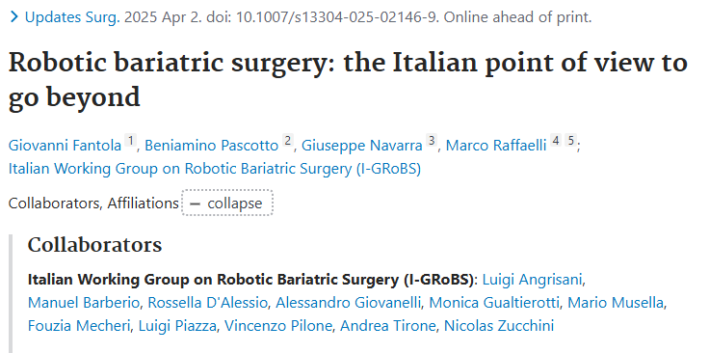

Slide 4
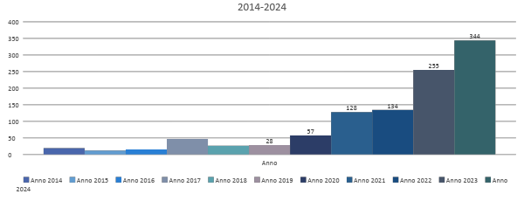
2014–2024 SICOB-R: out of 168,309 procedures, 1,086 (0.64%) were performed using a robotic approach

Slide 5

We planted the seed of robotic bariatric surgery in 2019, with patient is still growing..
3.7%
1.7%
0.1%

Slide 6


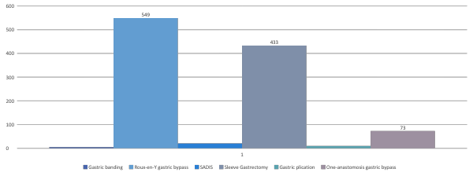
Robotic Era:
RYGB/OAGB more performed
Robotic Era:
2nd place for Sleeve gastrectomy (queen of lap)

Slide 7
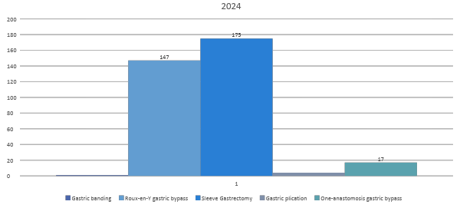
Considering just 2024...
Sleeve first surpassed RYGB/OAGB
Bypass 2nd place

Slide 8
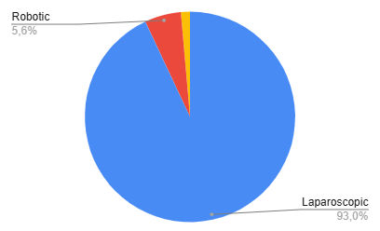
What about 2025?
Our preliminary results show:
Rise in % of robotic surgery
from 3.7% in 2024* –> 5.6% in 2025*
Rise in n tot of robotic procedures
from 344 in 2024* –> 443 in 2025*
Not yet specific numbers for first & second procedure
*first 10 months

Slide 9
Sicob Registry 443 in 2025*
What about 2025 (Da Vinci data)?
Italia 2025
23
Centri attivi
1200+
Pazienti trattati
Italia 2021
6
Centri attivi
180+
Pazienti trattati

Slide 10
What about other platform?
HUGO-Medtronic: 7 platforms in bariatric surgery
Policlinico Universitario Agostino Gemelli - Roma
Policlinico San Marco - Zingonia
Policlinico Sant’Orsola - Bologna
Gruppo Villa Maria -Kronosan – Cottignola
Pineta Grande Hospital – Caserta
Ospedale Niguarda - Milano
Campus Biomedico - Roma

Slide 11

Could robotic platforms be more useful than laparoscopy for achieving a safe and efficient learning curve?
Could it offer a viable path toward solo-surgery?
Could it value for AI applications, and for training and proctoring of new users?

Slide 12

Grazie

